Slide 1

Ethical Leadership and Societal Impact.
Andrew Bishop
Graduate and Professional Program, Saint Mary’s University of Minnesota
OL 655, Capstone Symposium
Dr. Jessica Samens
August 24, 2025

Slide 2
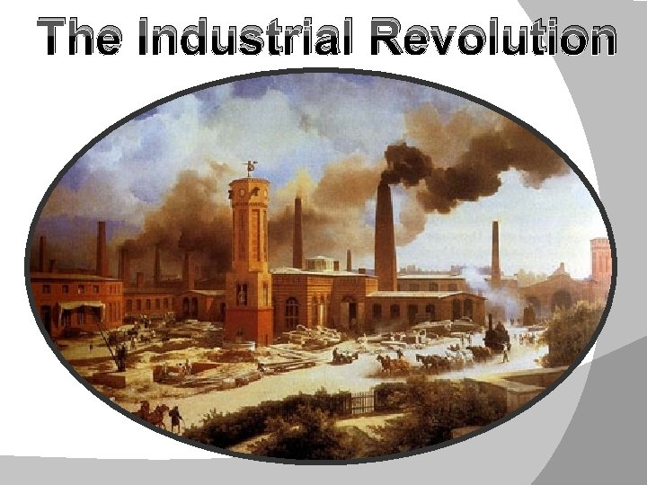
Ethical leadership and its impact on society have been interconnected throughout the years growing alongside religious and societal developments. As most recent as the 19th and 20th centuries, the Industrial revolution brought about new social challenges and an evolving awareness of ethical leadership and social responsibility.

Slide 3
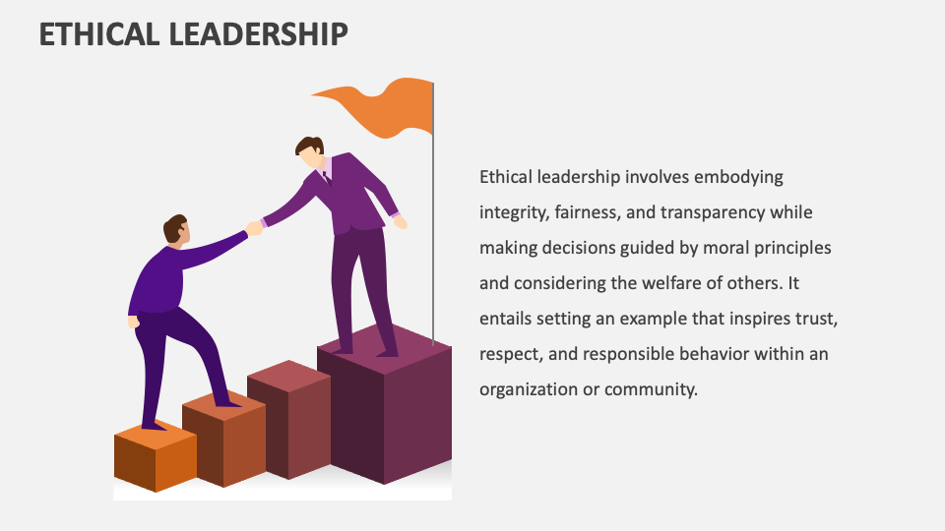

Slide 4
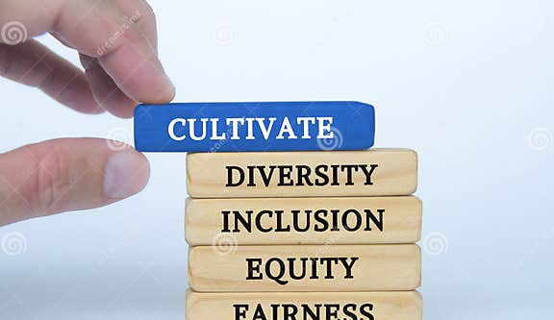

Slide 5

Promoting ethical decision-making: Investigating leadership practices that foster a culture of ethical conduct and accountability within organizations.
Leading with social responsibility: Exploring the role of leaders in promoting sustainable business practices, civic engagement, and positive community impact.
Addressing diversity, equity, and inclusion: Examining leadership strategies for creating inclusive environments and fostering cultural competence within organizations and communities.

Slide 6
Ethical Decision-Making Frameworks
Servant Leadership: This model emphasizes serving the needs of others (employees, customers, community) rather than seeking personal power. It promotes humility, selflessness, and fostering individual and collective growth, leading to a more ethical and collaborative environment.
Social impact models
Corporate Social Responsibility (CSR): CSR as a business model is where companies integrate social and environmental concerns into their operations and interactions with stakeholders. This includes initiatives like sustainable practices, community engagement, and philanthropy, aiming to create a positive societal impact.

Slide 7
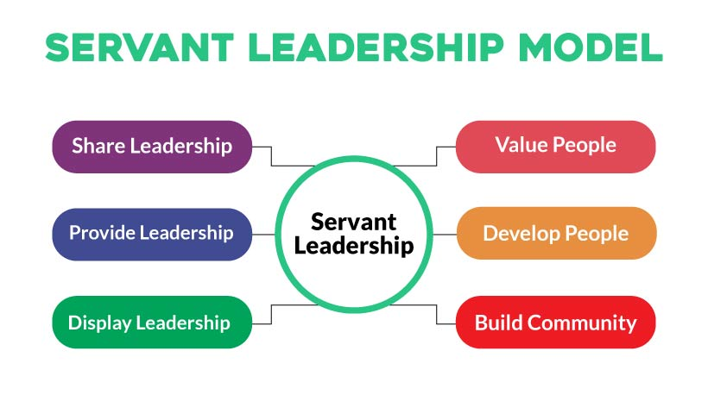

Slide 8
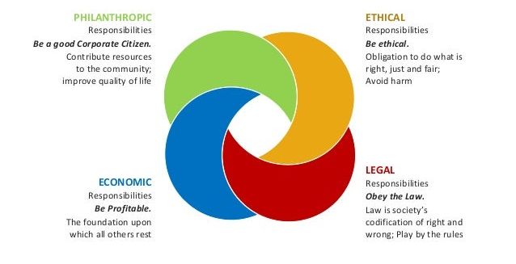

Slide 9
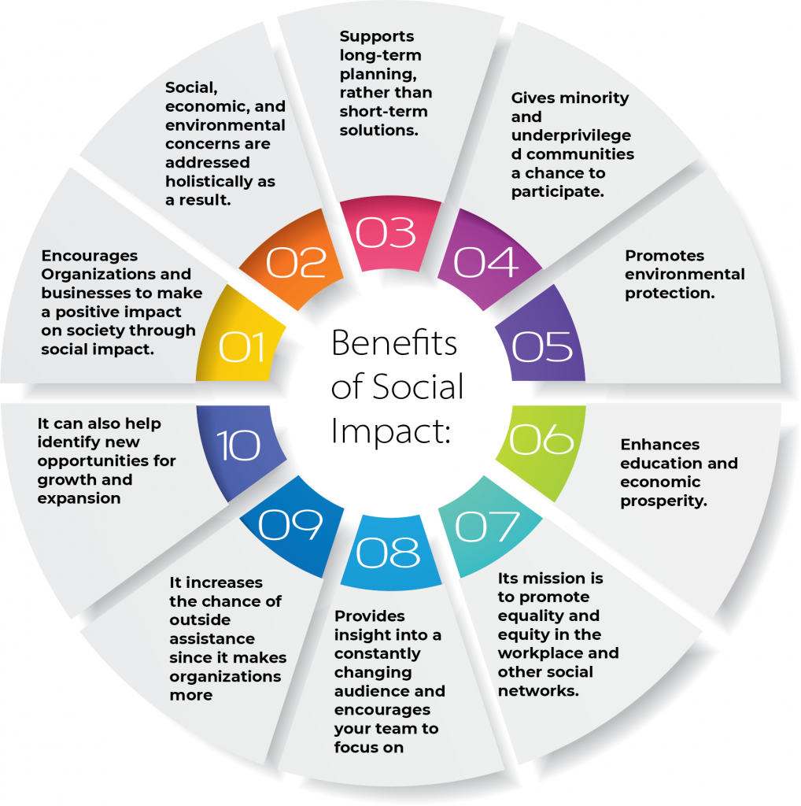
Societal Impact

Slide 10
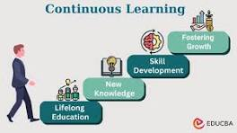
Continuous learning in ethical leadership and its societal impact encompasses proactively researching new knowledge, ideas, and adapting best business practices from other organizations that foster ethical decision-making and positively impacting societal change.

Slide 11

Goals and Impact

Slide 12
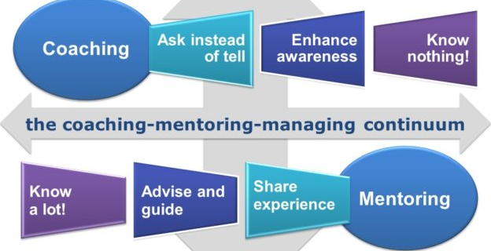

Slide 13
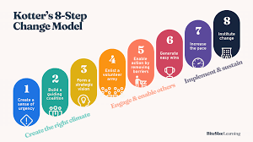
Change Management
Sourced from Management Study Guide

Slide 14
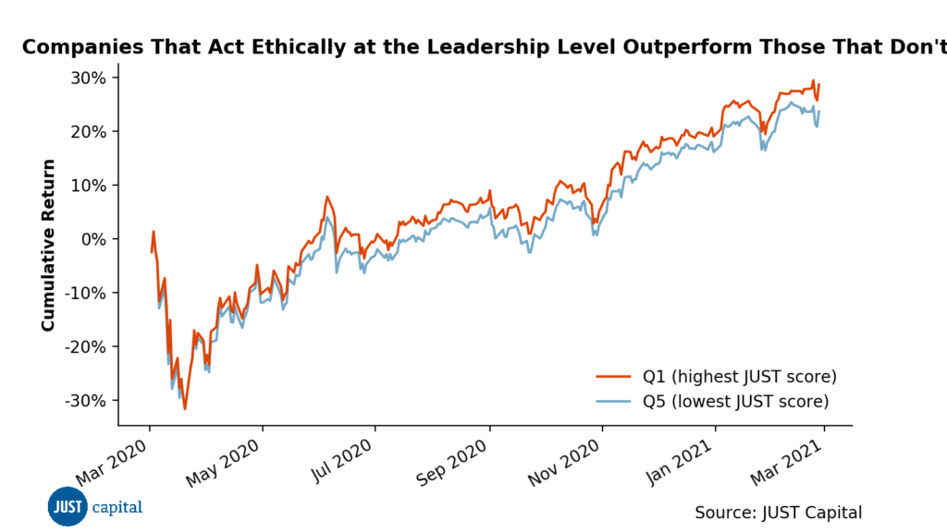
A recent survey showed that the American people consistently agree that ethical leadership should be a top priority for America’s largest companies. The survey showed that Americans identified ethical leadership as the #4 most important priority for companies in building more just business practices, and issues of ethical leadership – quantified through measures like corporate controversies, commitments to following laws & regulations, and legal fines & violations

Slide 15
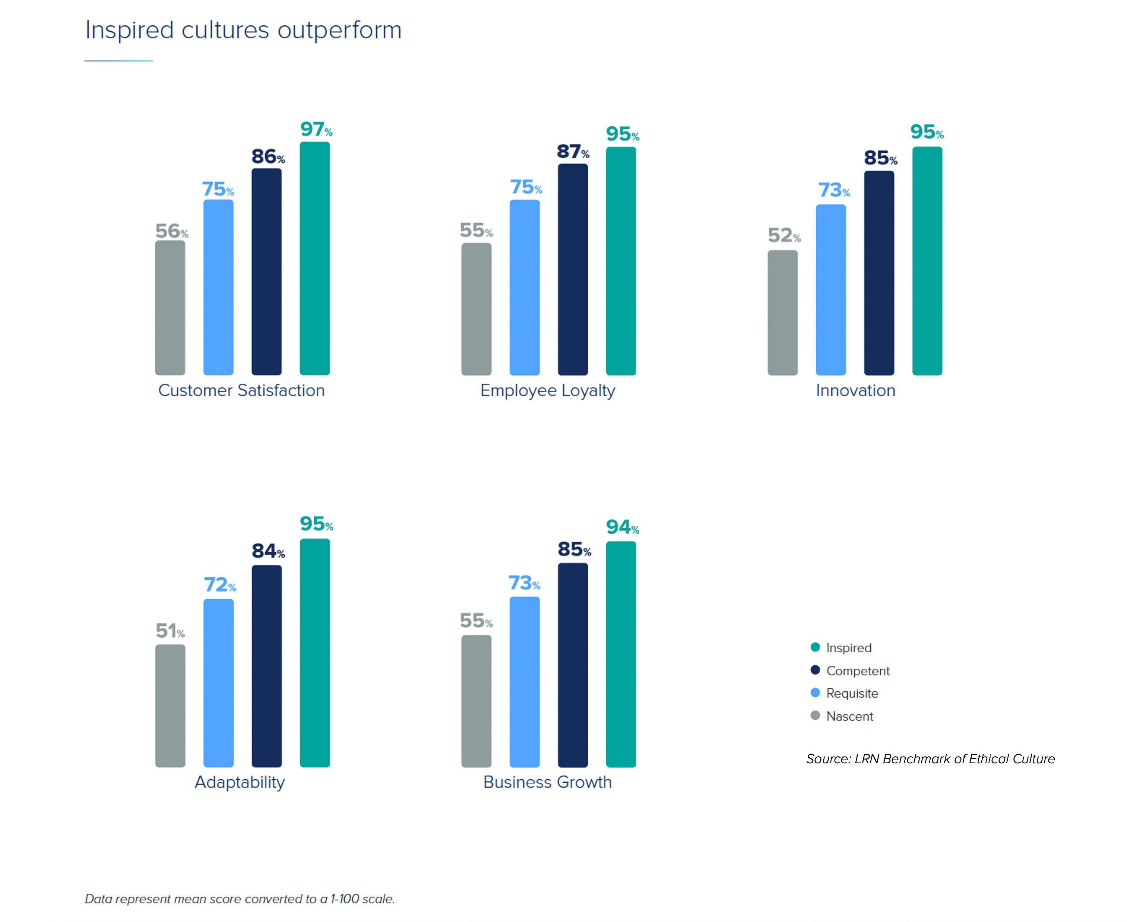
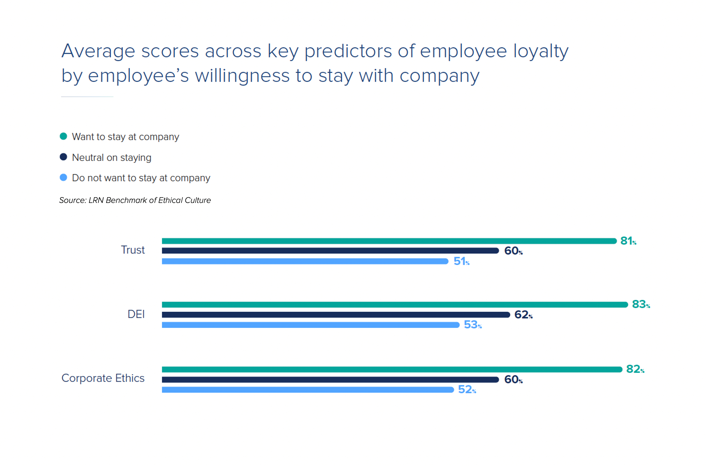
Ethical culture has a significant impact on business performance
Source taken from LRN, 15 Aug. 2025

Slide 16
Recommendations on Improving ethical leadership and social impact.
Fostering ethical leadership
Enhancing social impact
Define and communicate core values: Establishing a clear code of ethics and company values that guide all decisions and actions.
Lead by example: Leaders must embody the principles of ethical behavior, demonstrating honesty, integrity, fairness, accountability, and respect in all interactions.
Provide ethical training and development: Invest in training programs that equip employees and leaders with the skills and knowledge needed to navigate ethical dilemmas and uphold company values.
Implement ethical decision-making frameworks: Utilizing frameworks like the Utilitarian, Rights-Based, Justice, or Virtue Ethics approaches can help leaders make more intentional and well-balanced decisions when faced with ethical challenges.
Align social initiatives with business goals: Integrate creating shared value (CSV) into your business strategy and corporate culture, finding opportunities where economic and social value can be created simultaneously.
Be transparent and accountable: Clearly communicate your social goals, methodologies, and the impact achieved to stakeholders.
Measure and report on social impact: Implement robust systems and frameworks for assessing the social outcomes of your initiatives.
Adopt sustainable practices: Incorporate environmentally and socially responsible practices throughout your operations, from sourcing to production and waste management.
By focusing on these recommendations, organizations can cultivate ethical leaders and build a strong foundation for creating positive social change.

Slide 17

Ethical leadership paired with societal benefits
Example:
TOMS Shoes' "buy one, give one" model.
The core concept of this model is a form of social entrepreneurship, where a company's primary goal is to generate both profit and social impact, by merging for-profit business with charitable giving, allowing consumers to contribute to a social cause simply by purchasing a product.

Slide 18

The Dilemma of Ethical Leadership | Isabel Chavez Lopez .
In this TED talk Lopez delves into the dilemma of ethical leadership, spoke of the importance of maintaining ethical standards, even when faced with the pressure to prioritize success over power, to consistently do the right thing regardless of whether one is being watched
https://www.youtube.com/watch?v=3I2x1srXdHc

Slide 19

Conclusion
“Leadership is Dangerous” (Linskey, Heifetz, 2017, p.11) emphasizing that “If leadership were about giving people good news, the job would be easy”
Ethical leadership and social impact are inherently linked; ethical leadership supports a culture of responsibility and positive social change, while societal impact initiatives, in turn, emphasizes ethical behavior within an organization. Organizations that prioritize ethical leadership tend to garner stronger stakeholder relationships, enhanced reputations, and greater long-term sustainability. In essence there is a need for ethical leadership that demands social impact is more critical than ever. Studies have confirmed that there is an increasing demand in today’s business world for organizations to adopt and demonstrate socially responsible behavior towards society, to protect and adhere to laws and regulations which fosters a positive social impact when paired with the practice of ethical leadership. "Where the willingness is great, the difficulties cannot be great." (Machiavelli, 2018). This quote suggests that a leader's determination can overcome obstacles.

Slide 20
REFERENCES
Grace, Carolyn. “4 Data Charts That Make the Case for Culture in 2023 Business Strategy.” Lrn.com, LRN, 4 Jan. 2023, lrn.com/blog/4-data-charts-on-company-culture-for-2023-business-strategy-lrn-benchmark-of-ethical-culture.
Heifetz, R. A., & Linsky, M. (2017). Leadership on the Line, with a New Preface by the Authors: Staying Alive Through the Dangers of Leading. Harvard Business Review Press.
Juneja, Prachi. “Kotter’s 8 Step Model of Change.” Management Study Guide, 12 Feb. 2025, www.managementstudyguide.com/kotters-8-step-model-of-change.htm. Accessed 15 Aug. 2025.
Machiavelli, N., & Bull, G. (2003). The Prince. Penguin Classics.
TEDx Talks. “The Dilemma of Ethical Leadership | Isabel Chavez Lopez-Ibañez | TEDxAmericanSchoolOfGuatemala.” YouTube, 27 Mar. 2025, www.youtube.com/watch?v=3I2x1srXdHc. Accessed 18 Aug. 2025.

